Slide 2
Solution of the Task
Incrementing machine with two states
0/0, 1/1
q₁
0/1
q₀
1/0

Slide 3
Applications of Incrementing and Complementing machines
1’s complementing and incrementing machines which are basically Mealy machines are very much helpful in computing.
The incrementing machine helps in building a machine that can perform the addition of binary numbers.
Using the complementing machine along with incrementing machine, one can build a machine that can perform the subtraction of binary numbers.

Slide 4
Theorem
Statement:
For every Moore machine there is a Mealy machine that is equivalent to it (ignoring the extra character printed by the Moore machine).
Proof: Let M be a Moore machine, then shifting the output characters corresponding to each state to the labels of corresponding incoming transitions, machine thus obtained will be a Mealy machine equivalent to M.
Following is a note

Slide 5
Note
It may be noted that while converting a Moore machine into an equivalent Mealy machine, the output character of a state will be ignored if there is no incoming transition at that state. A loop at a state is also supposed to be an incoming transition.
Following is the example of converting a Moore machine into an equivalent Mealy machine

Slide 6
Example
Consider the following Moore machine
Using the method described earlier, the above machine may be equivalent to the following Mealy machine
q₀/0
a
q₁/1
b
b
a
a
q₂/0
b
q₃/1
a,b

Slide 7
Example continued ...
Running the string abbabbba on both the machines, the output string can be determined by the following table
q₀
a/1
q₁
b/0
b /0
a /1
a /0
q₂
b /1
q₃
a /1,b /1

Slide 8
Example continued ...
Input
a
b
b
a
b
b
b
a
States
q₀
q₁
q₂
q₃
q₃
q₃
q₃
q₃
q₃
Moore
0
1
0
1
1
1
1
1
1
Mealy
1
0
1
1
1
1
1
1

Slide 9
Theorem
Statement:
For every Mealy machine there is a Moore machine that is equivalent to it (ignoring the extra character printed the Moore machine).
Proof: Let M be a Mealy machine. At each state there are two possibilities for incoming transitions
The incoming transitions have the same output character.
The incoming transitions have different output characters.

Slide 10
Proof continued …
If all the transitions have same output characters, then shift that character to the corresponding state.
If all the transitions have different output characters, then the state will be converted to as many states as the number of different output characters for these transitions, which shows that if this happens at state q_{i} then q_{i} will be converted to q_{i}¹ and q_{i}² i.e. if at q_{i} there are the transitions with two output characters then q_{i}¹ for one character and q_{i}² for other character.

Slide 11
Proof continued …
Shift the output characters of the transitions to the corresponding new states q_{i}¹ and q_{i}². Moreover, these new states q_{i}¹ and q_{i}² should behave like q_{i} as well. Continuing the process, the machine thus obtained, will be a Moore machine equivalent to Mealy machine M.
Following is a note

Slide 12
Note
It may be noted that if there is no incoming transition at certain state then any of the output characters may be associated with that state.
It may also be noted that if the initial state is converted into more than one new states then only one of these new states will be considered to be the initial state. Following is an example

Slide 13
Example
Consider the following Mealy machine
q₁
b/1
q₂
a/0
a/0
a/1
b/1
q₀
b/0
q₃
a/1
b/1

Slide 14
Example continued ...
Shifting the output character 1 of transition b to q₀
q₁
b/1
q₂
a/0
a/0
a/1
b/1
b/0
q₃
q₀/1
a/1
b

Slide 15
Example continued ...
Shifting the output character 0 of transition a to q₁
b/1
q₂
q₁/0
a/0
a
a/1
b/1
b/0
q₃
q₀/1
a/1
b

Slide 16
Example continued ...
Shifting the output character 1 of transition b to q₂
q₁/0
b
q₂/1
a/0
a
a/1
b/1
b/0
q₃
q₀/1
a/1
b

Slide 17
Example continued ...
Splitting q₃ into q₃ and q₃
q₁/0
b
q₂/1
1
2
a
b
a
q₀/1
a
b
a
1
q₃/1
b
b
a
2
q₃/0

Slide 18
Theorem
Statement:
For every Mealy machine there is a Moore machine that is equivalent to it (ignoring the extra character printed the Moore machine).

Slide 19
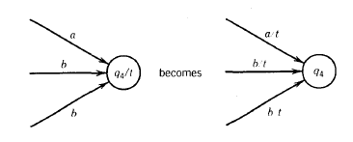
Steps

Slide 20
Context-Free Languages

Slide 21
Context-Free Languages
Regular Languages

Slide 22
Context-Free Languages
Context-Free
Grammars
Pushdown
Automata
stack
automaton

Slide 23
Context-Free Grammars

Slide 24
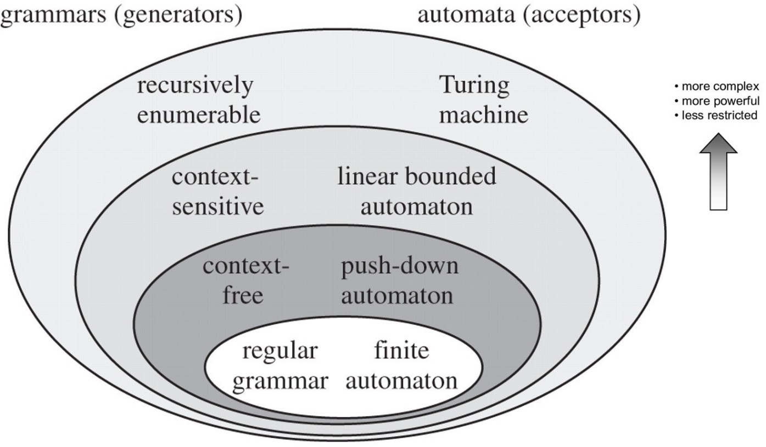

Slide 25
Example
A context-free grammar :
One non terminal → terminal/non terminal
A derivation:

Slide 26
A context-free grammar :
Another derivation:

